Slide 1






Penetration Testing For ProEngineer Website
CS352 Report 2
Group 12

Slide 2
TABLE OF CONTENTS
01
Terminology
Core Cybersecurity Principles
03
Penetration Testing Process
04
Vulnerability
05
Benefits of Penetration testing
06
Risk Management
02
07
Policies and Procedures
08
Conclusion

Slide 3
01
Terminology

Slide 4


1.) Shodan
Search engine which searches for internet connected devices
It discloses information about devices based on a range of IP Addresses

Slide 5

2.) Penetration Testing
Finding weakness in IT System by performing attack simulation.
Exploits vulnerabilities in system, network, human resource and physical assets.

Slide 6

02
Core Cybersecurity Principles Supported by Penetration Testing

Slide 7
Defense-in-Depth
Risk Management
Continuous Improvement
Compliance & Assurance
Ethical Conduct
Multiple layers of security controls and their effectiveness are verified
Identifies and prioritizes vulnerabilities based on potential impact.
Regular penetration testing helps adapting to evolving threats
Regulatory compliance are met through penetration testing
Tests are conducted by skilled, certified professionals

Slide 8
03
Penetration Testing Process

Slide 9
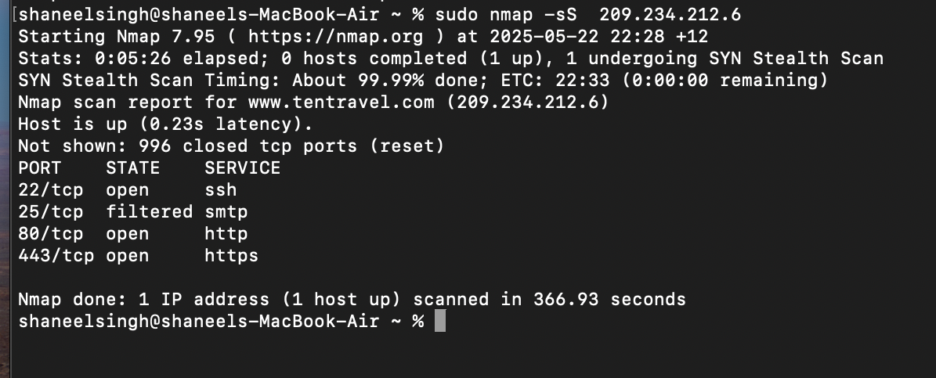
Step 1: Reconnaisse and Planning
The IP found using shodan.io was used in conjunction with the nmap framework in order to find open the open ports related to the IP address.
Once completed, the scan showed us the port numbers and its state, whether it was open or not.

Slide 10
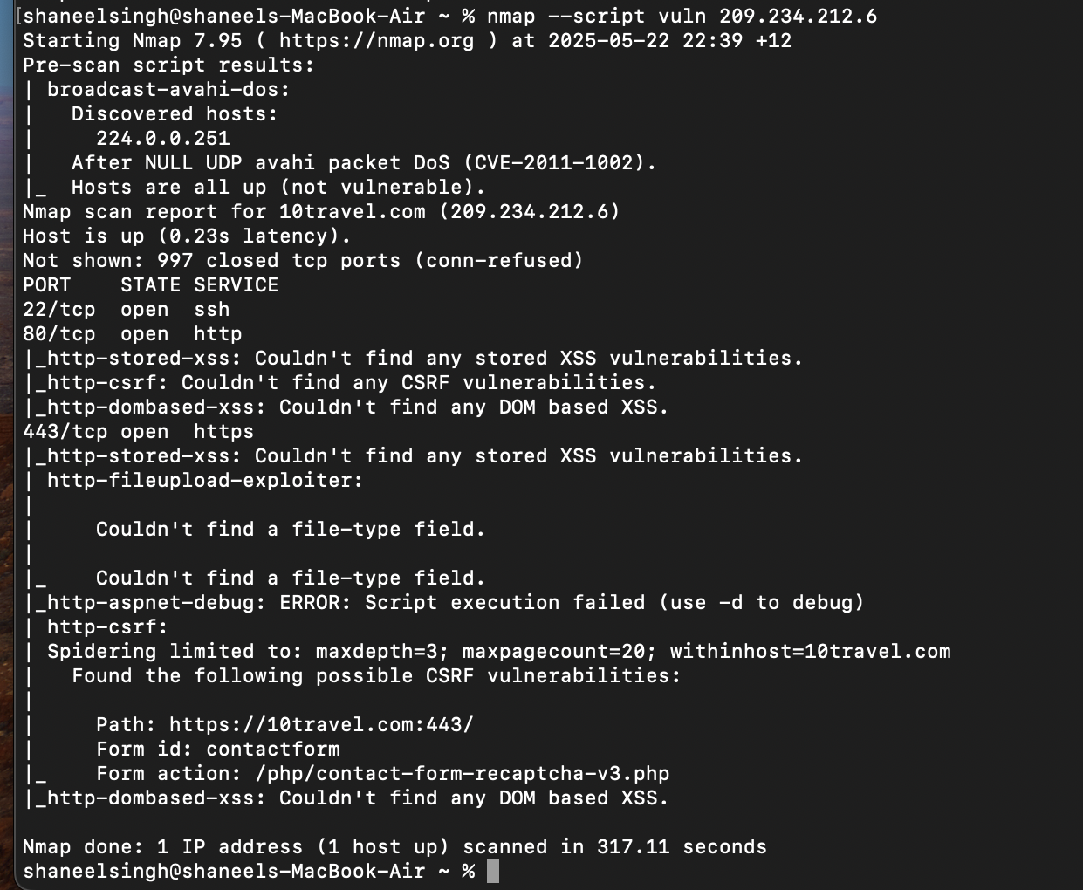
Step 2: Scanning for Current Vulnerabilities
Based on the Scan results, it was concluded that there were no CURRENT vulnerabilities detected
This information meant that further steps in the Penetration testing could not take place.

Slide 11
04
Vulnerability

Slide 12
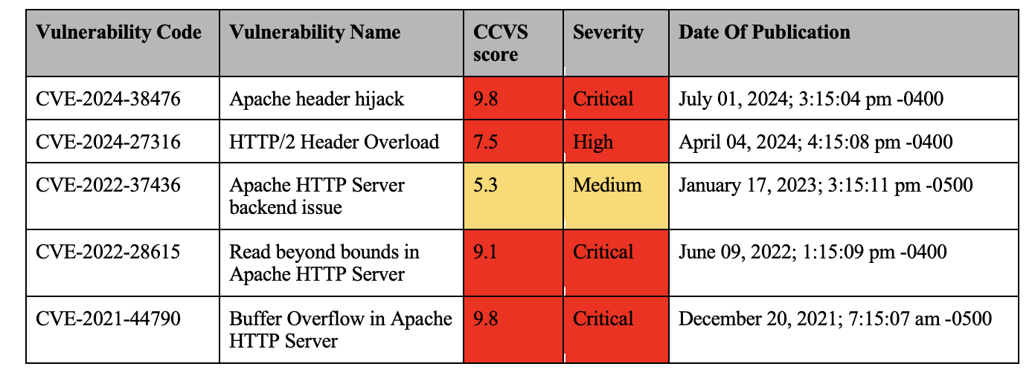
PAST VULNERABILITY ANALYSIS

Slide 13
Further Analysis
Critical vulnerabilities like CVE-2024-38476 (Apache header hijack, CVSS 9.8), CVE-2022-28615 (Read beyond bounds, CVSS 9.1), and CVE-2021-44790 (Buffer Overflow, CVSS 9.8) could allow attackers to take full control of the server, manipulate data, or cause denial-of-service.
These vulnerabilities, if unpatched, pose a significant threat to web servers, especially since Apache HTTP Server is widely used, making it a prime target for exploitation.

Slide 14
Benefits of Penetration Testing in Mitigating Risks
05

Slide 15
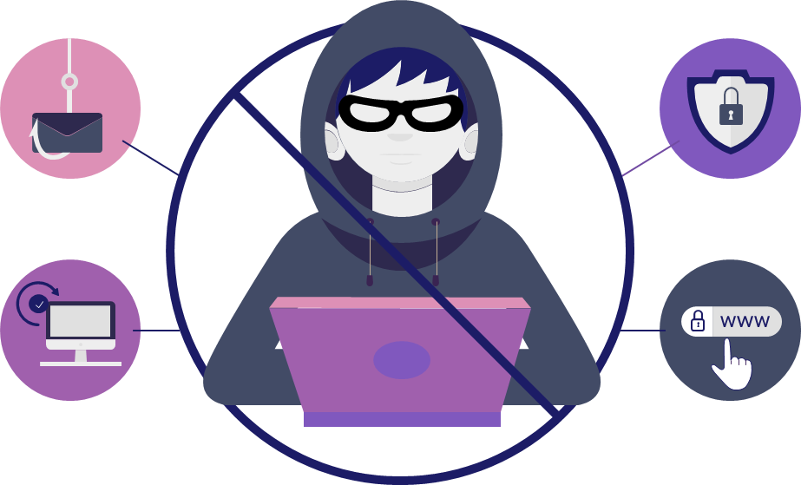
Benefits
Finds and fixes security flaws.
Protects cyber security incidents before it occurs.

Slide 16
06
Risk Management

Slide 17

Apache header hijack is the major risk
Other risks: HTTP/2 Overload, Apache server backend issue, and buffer overflow
Recommendation: upgrading to updated versions of server

Slide 18
Policies and Procedures supporting Cybersecurity Protection
07

Slide 19
Regular Patch Management
01
Access Control
02
03
Continuous Security Control Testing
04
Use of HTTP Security Headers
Process where IT specialists deploy relevant updates to software, firmware, drivers and API’s
A mechanism that controls or regulates the accessing of particular information in computing environment
Important as it is able to identify weakness in the security measures implemented
HTTP security header passes additional security features and information with HTTP requests or responses

Slide 20

Conclusion

Slide 21




The Pro/ Engineer Wildfire Website had severe vulnerabilities
Measures such as access control, regular patching and security control should be used
Penetration testing plays an important part in preventing cyber incidents

Slide 22




MEET THE TEAM
Krish Rao
Shivam Prasad
Josephine Mudliar
Shaneel Singh

